Slide 1
How to enroll students in CMS From admission

Slide 2
Content
Admission module
Merit register
Filter Record
Create students
<number>

Slide 3
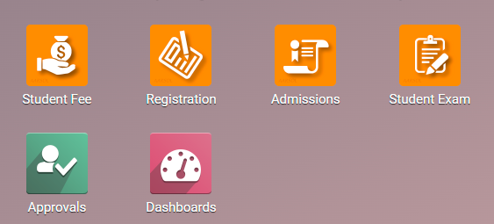
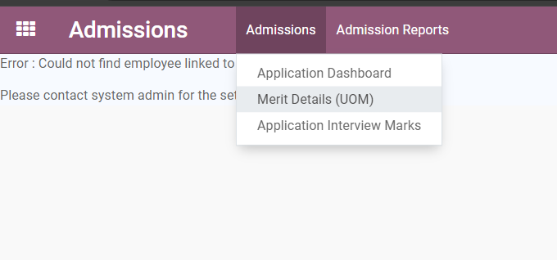
1. Admission module
To enrolled students in CMS go to Admission Module then click on Admission Menu and under admission click on Merit Details (UOM).
<number>

Slide 4
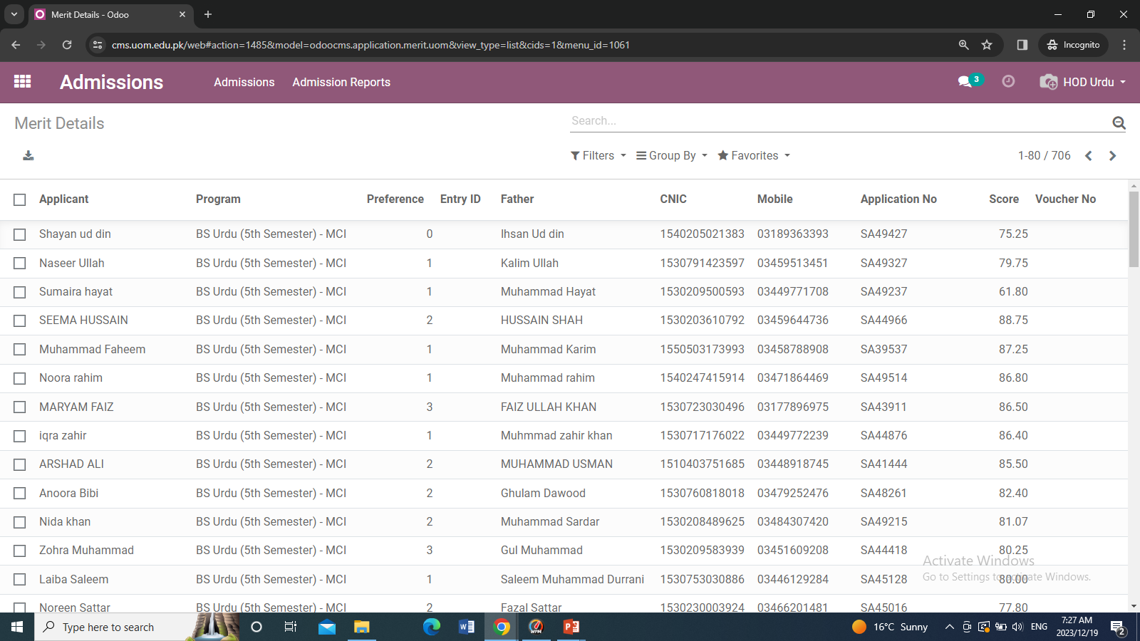
2. Merit Register
After clicking on merit details uom you will see the following records.
<number>

Slide 5
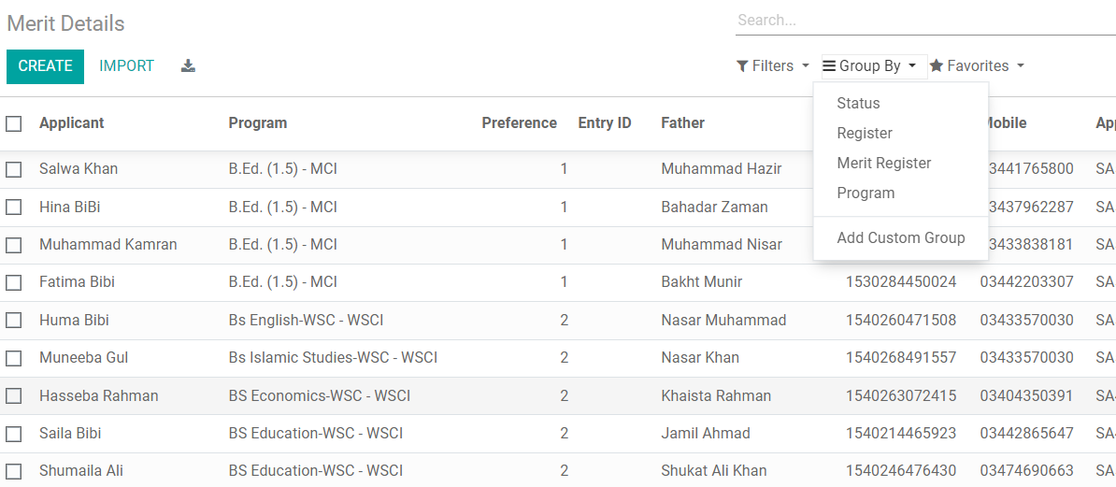
3. Filter Record
To see the record in proper format or register wise, status you need to use group by option. Which present in the middle of screen. So in that first select Merit register then program and last status.
<number>

Slide 6
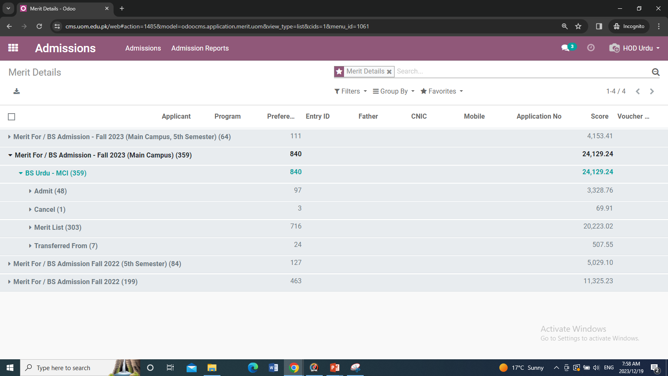
After filtering the record it shows like this as shown below
Admit : contain students admitted by department .
Cancel : contain students which cancelled admission.
<number>

Slide 7
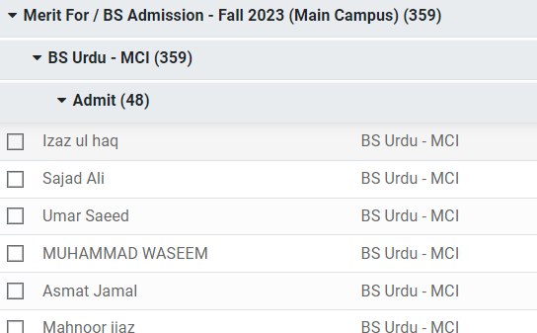
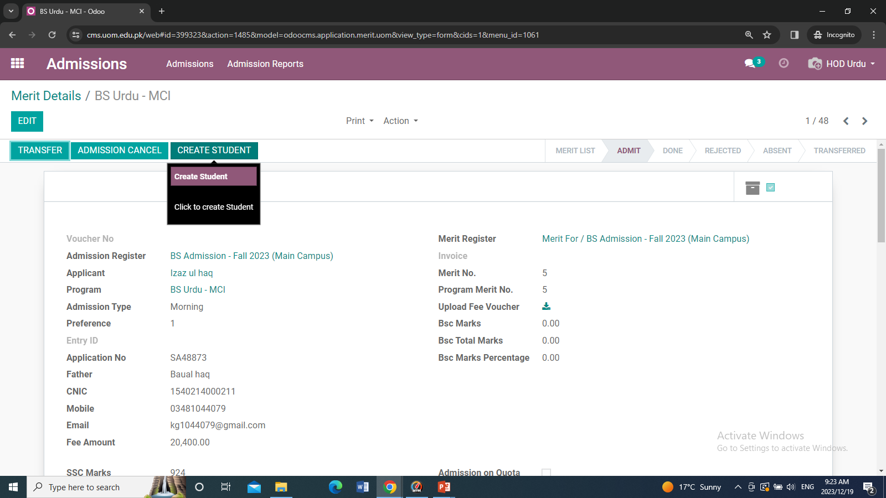
4. Create Students
Open the admitted record and open a student which contains the button CREATE STUDNETS click on it. so the student enrolls to Odoo CMS module and their User credential is sent via email.
<number>

Slide 8
Thank You

